Slide 1
Lung Cancer Detection Using Machine Learning Approaches
Amina Nawaz (fa-20/bscs/093/C)
Laraib Masood (fa-20/bscs/534/C)
Supervisor (Sir Umer Ahmad)
Project ID: (64)

Slide 2
Introduction
Lung tumor is cancer that forms in tissues of the lung, usually in the cells that line the air passages.
It is the leading cause of cancer death.
Two kinds of Lung Cancer:
SCLC
NSCLC

Slide 3
Problem Description
Lung cancer is one of the leading causes of cancer-related deaths worldwide.
Early detection plays a crucial role in improving treatment outcomes and survival rates.
Machine learning approaches have shown promise in aiding the detection and diagnosis of lung cancer through the analysis of medical imaging data, such as chest X-rays and CT scans.

Slide 4
Project Objective/Scope
The project centers on the machine learning methodologies to enhance the precision of ling tumor detection using computational approaches.
It encompasses the development, training and validation of machine learning models utilizing Python, Scikit, Tensorflow, Numpy and Pandas libraries
The scope focuses on utilizing chest CT scan data for accurate identification and classification of lung tumor.

Slide 5
Literature Review
Lung cancer is one of the most common and deadliest cancers worldwide, with early detection being crucial for effective treatment.
Machine learning techniques have shown promise in various medical applications, including disease detection and diagnosis.
Naïve Bayes is a simple yet powerful probabilistic classifier based on Bayes’ theorem. It assumes independence among features, making it computationally efficient and effective for classification tasks.
Genetic algorithms are optimization techniques inspired by natural selection and genetics. They use a population-based approach to evolve solutions to optimization problems.
Hybridizing of Genetic algorithms with Naïve Bayes offer potential advantages such as enhanced feature selection, improved classification accuracy and better generalization to unseen data.
Conclude by highlighting the significance of the hybrid GA-Naïve Bayes approach for lung cancer detection and suggest potential future research directions such as exploring other hybridization strategies or incorporating additional data sources.

Slide 6
Techniques Used
Following are the interfaces used for detection:
Software Specifications | Description
Python 3 | Python 3 is commonly used for developing websites and software, task automation, data analysis and data visualization.
Streamlit | It is an open-source app framework written in python. It is classified as an open-source app framework because it enables the rapid development and sharing of interactive data applications with minimal coding and no need for complex web development skills.
Google COLAB | Colab allows anybody to write and execute arbitrary python code through the browser.
Pandas | It is a software library written for python for data manipulation and analysis.
Numpy | Numpy is a software library written for python used for working with arrays.

Slide 7
Project Milestones and deliverables
Phase | Week | Duration | Semester
Project and Supervisor Selection | Week 02 | 2 Weeks | 7th
Proposal Defense | Week 06 | 1 Week | 7th
Mid Defense | Week 14 | 1 Week | 7th
Final Report Submission | Week 14 | 1 Week | 8th
Final Defense | Week 14/15 | 1 Week | 8th

Slide 8
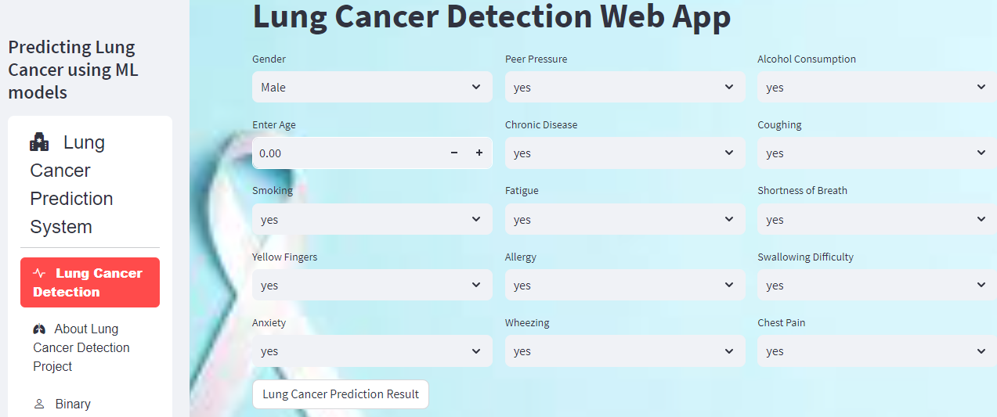
Project Results

Slide 9
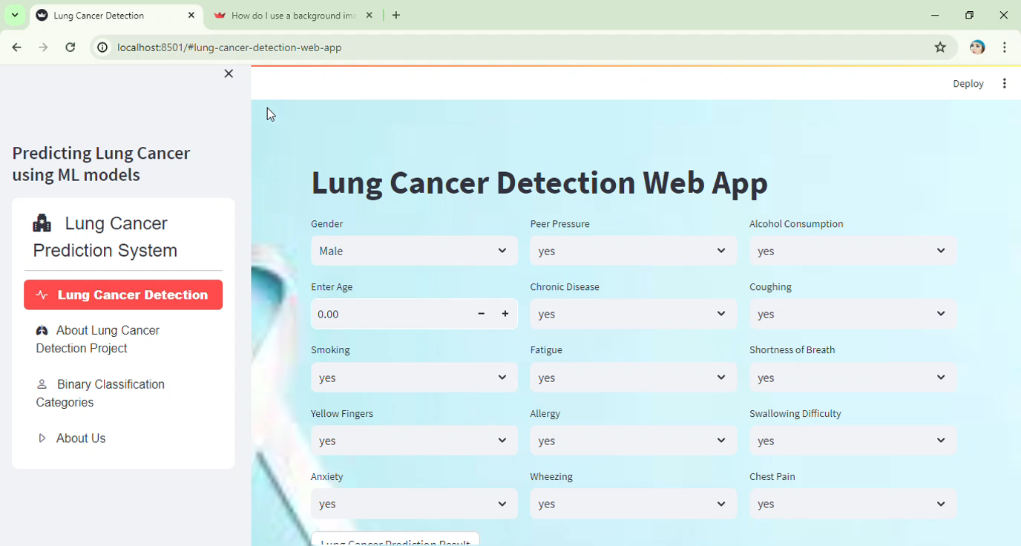

Slide 10
Conclusion
The Lung Cancer Detection using Hybrid Genetic Algorithm and Naïve Bayes project has successfully developed an advanced and effective system for early detection of ling cancer using a hybrid approach.
The integration of Genetic Algorithm for feature selection and Naïve Bayes for classification has proven to be highly beneficial in achieving accurate and reliable detection results.
The project’s results demonstrate the superior performance of the hybrid GA and NB model compared to baseline models, highlighting its potential as a valuable tool in the fight against lung cancer.
This enhances the system’s acceptance in the medical community and fosters trust in its application as an assisting tool for healthcare professionals in early lung cancer detection.

Slide 11
References
[1] Abdullah, D. M. & Ahmed, N. S. (2021). A Review of most Recent Lung Cancer Detection Techniques using Machine Learning. International Journal of Science and Business, 5(3), 159-173. doi: https://doi.org/10.5281/zenodo.4536818
[2] Jiang, the IEEE International Conference on Data Mining (ICDM), 2018. [Online]. Available: https://www.ncbi.nlm.nih.gov/pmc/articles/PMC5977652/
[3] "What Causes Lung Cancer?," American Cancer Society, 2021. [Online].Available: https://www.cancer.org/cancer/types/lung-cancer/causes-risks-prevention/what-causes.html
[4] "Lung Cancer Screening (PDQ®)–Patient Version," National Cancer Institute., 2021. [Online]. Available: https://www.cancer.gov/types/lung/patient/lung-screening-pdq
[5]A. A. Nagra, I. Mubarik, M. M. Asif, K. Masood, M. A. A. Ghamdi, and S. H. Almotiri, “Hybrid GANB Approach for Postoperative Life Expectancy Prediction in Lung Cancer Patients,” Applied Sciences, vol. 12, no. 21, p. 10927, Oct. 2022. [Online]. Available: https://www.mdpi.com/2076- 3417/12/21/10927

